Slide 1
Inspired by the Sea
Day 1
Your new unit is introducing you to writers and information that is inspired by the sea. Let’s look at these two videos to give you an idea about the sea
http://www.youtube.com/watch?v=7Ktkgeib6l8
http://www.youtube.com/watch?v=y1TxLBXx_FQ&feature=related

Slide 2

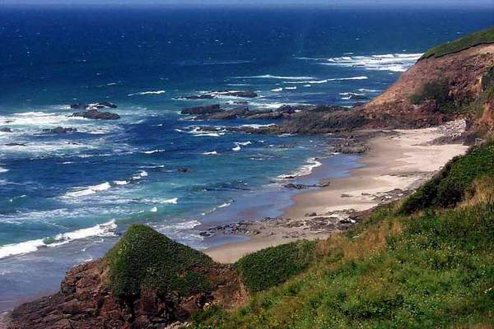
Essential Question
Why does the sea inspire writers?

Slide 3
Our Goal: I will use information from the text to describe characters and their actions in the story.
Rate yourself
1 – 2 – 3 - 4
Think back to The Stories Julian Tells. We used character traits to describe Julian. Turn and tell a partner what some of those character traits were.

Slide 4

We are going to listen to this story and learn about how the characters impact the outcome.

Slide 5
While I am reading the first part Amos & Boris today, I want you to think about Amos. Use the character sheet to record some things you learn about Amos. We can add to the character sketch tomorrow.
Notes from listening to the story | Notes from listening to the story
What kind of character traits does Amos have? | What kind of character traits does Boris have?
Choose a trait of Amos. What happens in the story because of this trait? | Choose a trait of Boris. What happens in the story because of this trait?

Slide 6
Our Goal Today:
I will use information from the text to describe characters and their actions in the story.
Rate yourself
1 – 2 – 3 - 4
Rate your effort today
1-2-3-4

Slide 7
Literature
Day 2
Our Goal for Today:
I will use information from the text to describe characters and their actions in the story.
Rate yourself
1 – 2 – 3 - 4

Slide 8
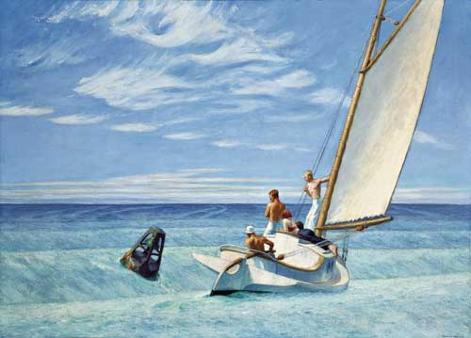
Ground Swell
Edward Hopper (1939)
Notes:
Edward Hopper, Ground Swell (1939)
Prominent American realist painter and printmaker.

Slide 9
We are going to use our sheet from yesterday to take notes on Boris. We know that characters are important in stories. They keep the action moving and they keep the reader interested.
Notes from listening to the story | Notes from listening to the story
What kind of character traits does Amos have? | What kind of character traits does Boris have?
Choose a trait of Amos. What happens in the story because of this trait? | Choose a trait of Boris. What happens in the story because of this trait?

Slide 10
Our Goal Today:
I will use information from the text to describe characters and their actions in the story.
Rate yourself
1 – 2 – 3 - 4

Slide 11
I will determine the main idea of a text and tell how key details support the main idea.
Rate yourself
1-2-3-4
Day 3

Slide 12
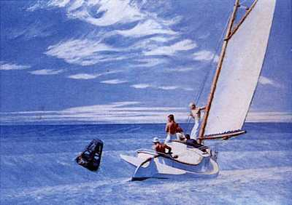
Ground Swell
Edward Hopper (1939)
Notes:
Edward Hopper (July 22, 1882 – May 15, 1967) was a prominent American realist painter and printmaker.
What do you think is the main idea of this painting? Maybe the sailboat? Why? It is the focus of the painting. When you look at this painting, sailboat “sticks” out. The main idea is like that with text.

Slide 13
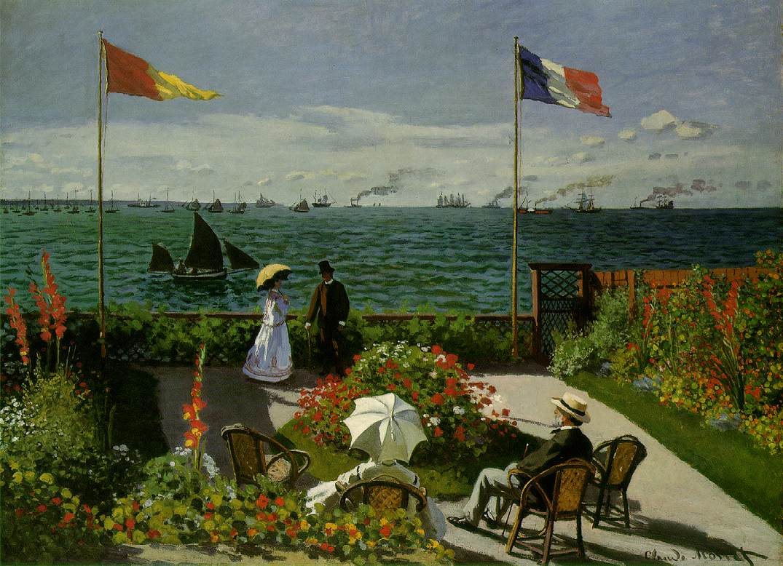
Garden at Sainte-Adresse
Calude Monet (1867)
Notes:
by the French impressionist painter, Claude Monet.
What do you think the main idea is of this painting? You will get several different answers because there are different things to look at. Maybe the couple standing, maybe the couple sitting down. Sometimes when we read fiction and non-fiction text, the main idea MAY NOT jump right out.
The painting was exhibited at the 4th Impressionist exhibition, Paris, April 10–May 11, 1879, as no. 157 under the title Jardin à Sainte-Adresse.
Monet spent the summer of 1867 at the resort town of Sainte-Adresse on the English Channel, near Le Havre (France). It was there, in a garden with a view of Honfleur on the horizon, that he painted this picture, which combines smooth, traditionally rendered areas with sparkling passages of rapid, separate brushwork, and spots of pure colour.

Slide 14

The Main Idea is what the author wants you to remember most

Slide 15
I will determine the main idea of a text and tell how key details support the main idea.
Rate yourself
1-2-3-4
Day 3

Slide 16
Day 4
I will determine the main idea of a text and tell how key details support the main idea.

Slide 18

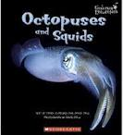


Now it’s your turn!

Slide 19
Day 4
I will determine the main idea of a text and tell how key details support the main idea.

